Slide 1
Empowering India: Analysing The Evolution Of Union Budget Allocations For Sustainable Growth

Slide 2
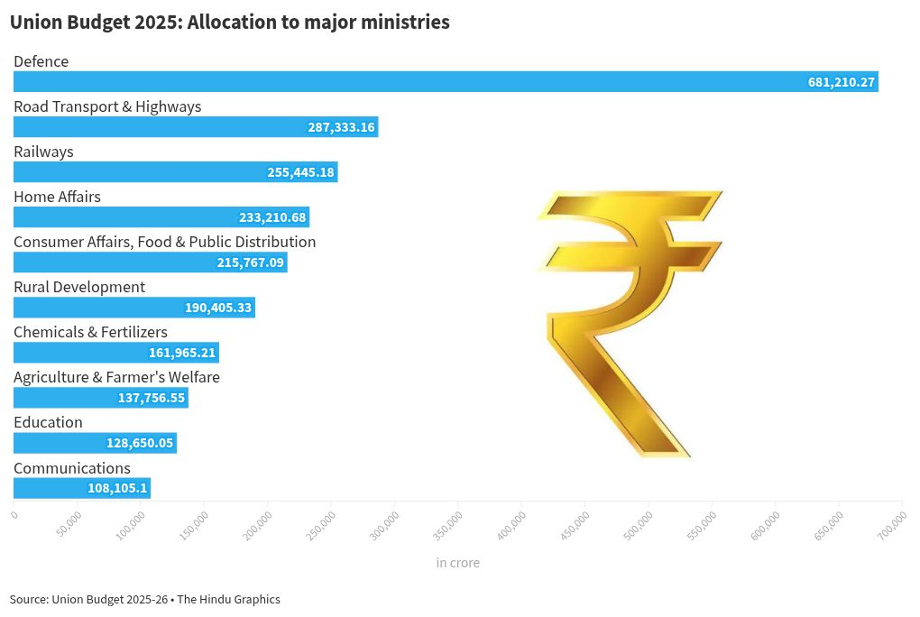
Empowering India: An Overview
This presentation explores the evolution of Union Budget allocations aimed at fostering sustainable growth in India.
It highlights key trends, priorities, and shifts over recent years.
Understanding these patterns is crucial for assessing India's progress towards sustainable development.
Notes:
Image source: https://public.flourish.studio

Slide 3
Importance of Budget Allocations for Sustainable Growth
Budget allocations are vital for financing initiatives that promote economic, social, and environmental sustainability.
They reflect government priorities and commitment to long-term development goals.
Analyzing these allocations helps identify areas of focused intervention and potential gaps.
Notes:
Image source: https://thetopnews.in

Slide 4
Historical Context of Budget Allocations (2010-2015)
During this period, India increased allocations toward infrastructure, health, and education sectors.
Emphasis was placed on inclusive growth and rural development programs.
Budget allocations showed initial steps toward integrating sustainability into development planning.
Notes:
Image source: https://thetopnews.in

Slide 5
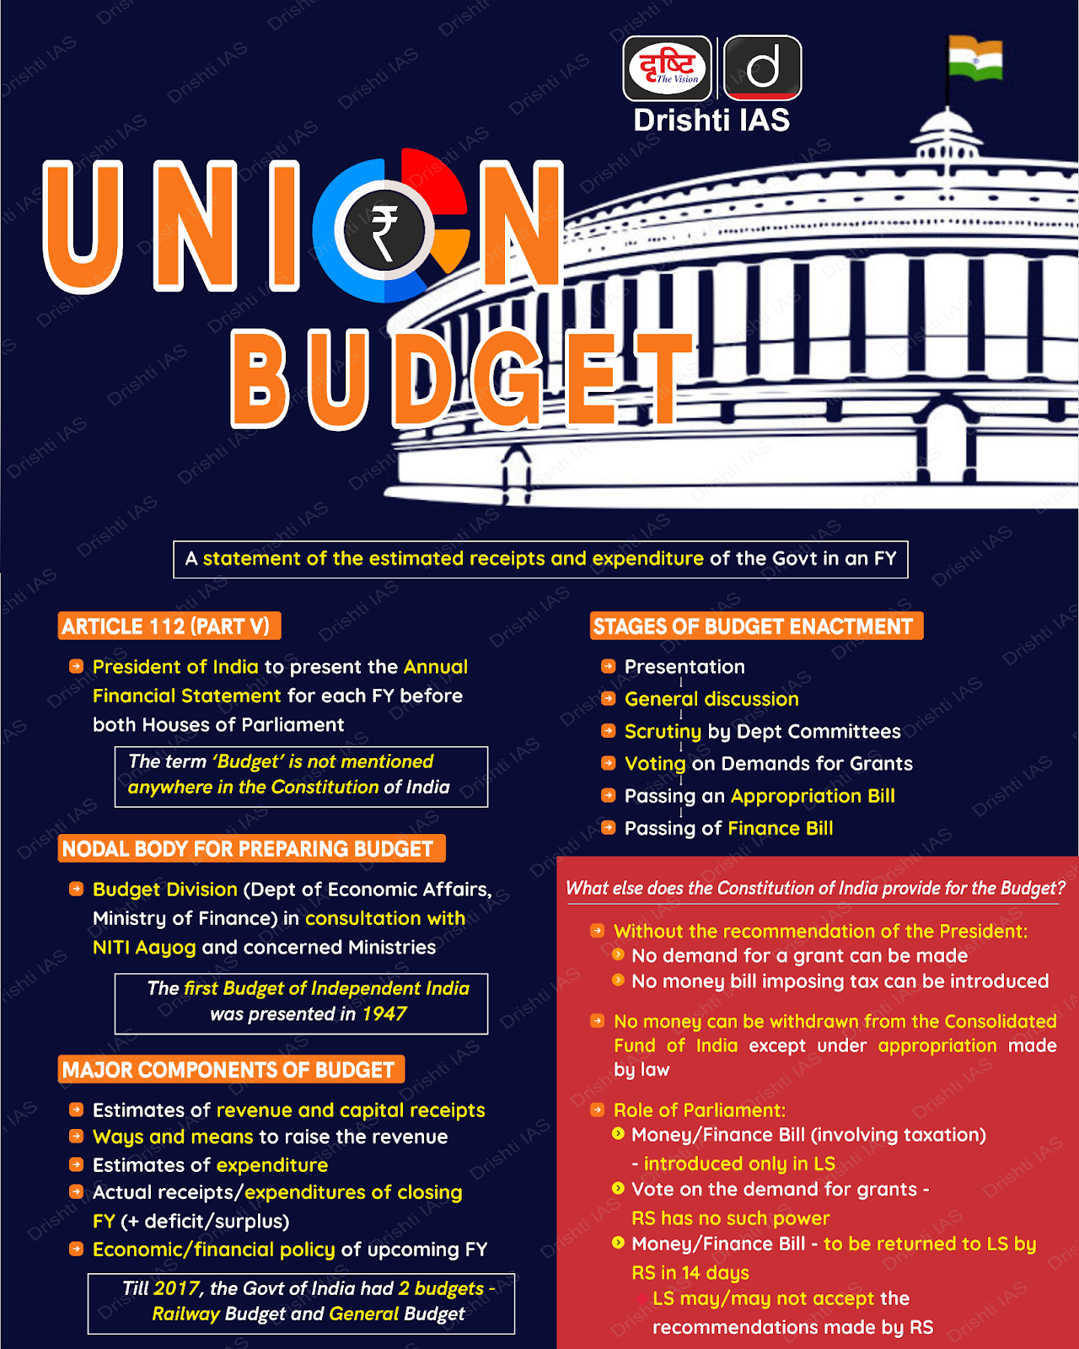
Shift Towards Sustainability in Budget Priorities (2016-2020)
The government began emphasizing renewable energy, climate resilience, and clean technology.
Allocations to environmental protection and sustainable agriculture increased significantly.
Policy initiatives aimed at reducing carbon footprint and promoting green growth were introduced.
Notes:
Image source: https://drishtiias.com

Slide 6
Impact of Budget Allocations on Renewable Energy Sector
Significant funding was directed toward solar and wind energy projects.
The budget supported policies to attract private investments in clean energy.
These allocations contributed to India’s ambition of achieving 500 GW of non-fossil fuel capacity by 2030.
Notes:
Image source: https://thetopnews.in

Slide 7
Focus on Social Sectors for Sustainable Development
Allocations for health, education, and social welfare increased to promote human capital development.
Initiatives like Ayushman Bharat and Skill India received enhanced funding.
Strengthening social infrastructure is seen as essential for sustainable economic growth.
Notes:
Image source: https://public.flourish.studio

Slide 8
Challenges in Budget Implementation and Allocation Efficiency
Despite increased allocations, effective utilization remains a challenge due to bureaucratic hurdles.
There is a need for better monitoring and transparency in expenditure.
Addressing these issues is crucial to ensure that budget allocations translate into tangible sustainable outcomes.
Notes:
Image source: https://drishtiias.com

Slide 9
Future Trends and Policy Directions
Upcoming budgets are expected to further prioritize climate action and sustainable urban development.
Digital technology and innovation are likely to be integrated into sustainability initiatives.
Continued focus on inclusive growth will be essential to balance economic and environmental goals.
Notes:
Image source: https://drishtiias.com

Slide 10
Conclusion: Progress and Path Forward
India has made notable progress in reallocating budgets toward sustainability.
Sustainable growth requires sustained commitment, effective implementation, and adaptive policies.
Ongoing analysis of budget trends is essential to ensure India’s development remains aligned with sustainability objectives.
Notes:
Image source: https://public.flourish.studio

Slide 11
Thank You
Thank you for exploring the evolution of India’s Union Budget allocations for sustainable growth.
Your engagement is vital for understanding and supporting India’s sustainable development journey.
For further insights, please refer to detailed reports and policy documents on this topic.
Notes:
Image source: https://public.flourish.studio

